Slide 1
Human Resource Management
Fifteenth Edition
Chapter 4
Strategic Planning, Human Resource Planning, and Job Analysis
Copyright © 2019, 2016, 2014 Pearson Education, Inc. All Rights Reserved
Notes:
If this PowerPoint presentation contains mathematical equations, you may need to check that your computer has the following installed:
1) MathType Plugin
2) Math Player (free versions available)
3) NVDA Reader (free versions available)

Slide 2
Learning Objectives
4.1 Describe the H R strategic planning process.
4.2 Explain the human resource planning process.
4.3 Describe the job analysis process and methods.
4.4 Summarize the components of a job description.
4.5 Explain what competencies and competency modeling are.
4.6 Summarize job design concepts.

Slide 3
Strategic Planning
Four steps:
Determination of the organizational mission
Assessment of the organization and its environment
Setting of specific objectives or direction
Determination of strategies to accomplish those objectives
Notes:
Strategic planning is the process by which top management determines overall organizational purposes and objectives and how they are achieved. HR executives are increasingly highly involved in the strategic planning process.
Strategic planning at all levels of the organization can be divided into four steps: (1) determination of the organizational mission, (2) assessment of the organization and its environment, (3) setting of specific objectives or direction, and (4) determination of strategies to accomplish those objectives.

Slide 4
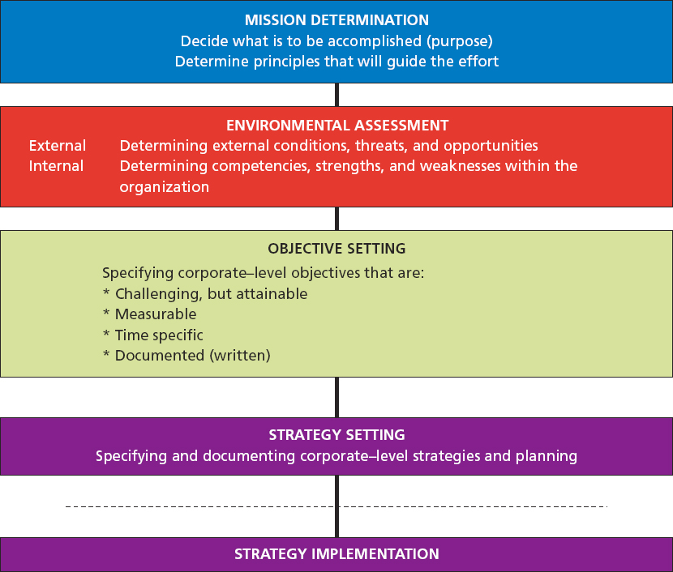
Strategic Planning/Implementation Process
Notes:
Strategic planning on all levels of the organization can be divided into four steps:
Determining the organizational mission,
Assessing the organization and its environment,
Setting specific objectives or direction, and
Determining strategies to accomplish these objectives.
The strategic planning process described here derives from the SWOT (strengths, weaknesses, opportunities, and threats) framework that affects organizational performance.
The mission is a unit’s continuing purpose or reason for being. The corporate mission is the sum total of the organization’s ongoing purpose.
Making strategic plans involves information flows from both the internal and the external environments. From inside comes information about organizational competencies, strengths, and weaknesses. Scanning the external environment allows organizational strategists to identify threats and opportunities, as well as constraints. In brief, the strategy would be to take advantage of the company’s strengths and minimize its weaknesses to grasp opportunities and avoid threats.
Objectives are the desired end results of any activity. They should have four basic characteristics: expressed in writing, measurable, specific as to time, and challenging but attainable.
Strategies can now be developed for accomplishing those objectives. Strategies should be developed to take advantage of the company’s strengths and minimize its weaknesses to grasp opportunities and avoid threats. Lowest cost strategies focus on gaining competitive advantage by being the lowest-cost producer of a product or service within the marketplace, while selling the product or service at a price advantage relative to the industry average. Companies adopt differentiation strategies to develop products or services that are unique from those of their competitors.

Slide 5
Strategy Implementation
Leadership
Organizational Structure
Information and Control Systems
Technology
Human Resources
Notes:
Strategy implementation follows the strategic planning process. It requires changes in the organization’s behavior, which can be brought about by changing one or more organizational dimensions which include: management’s leadership ability, organizational structure, information and control systems, production technology, and human resources.

Slide 6
Human Resource Planning (Workforce Planning)
Matching the internal and external supply of candidates with job openings anticipated in the organization over a specific period of time
Notes:
Human resource planning (workforce planning) is the systematic process of matching the internal and external supply of people with job openings anticipated in the organization over a specific period of time. Workforce planning has evolved from a knee-jerk planning undertaking to a fundamental strategic function. It includes business plan, human resource data, and statistical interactions. It is also incorporated into the business and financial planning process, so it provides a foundation for a plan that is aligned with the business strategy

Slide 7
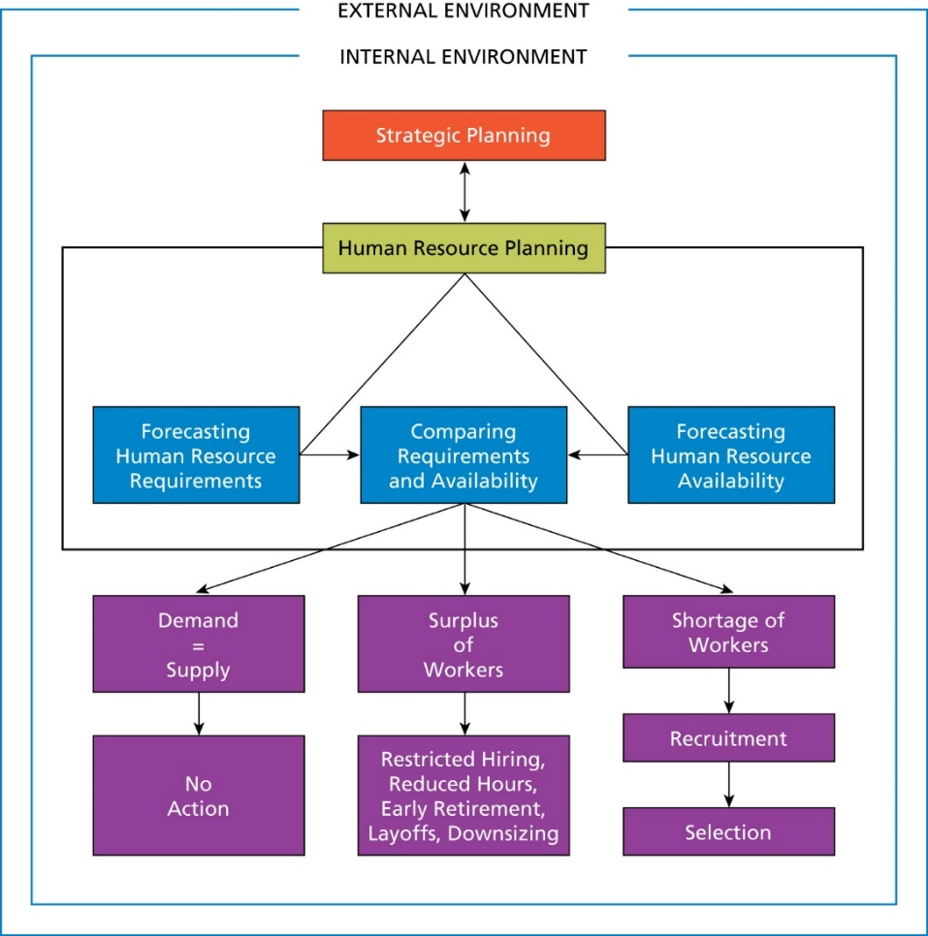
Human Resource Planning Process
Notes:
Strategic planning precedes HR planning. Human resource planning has two components: requirements and availability, which determine if the firm needs to hire or reduce the number of its employees and how.

Slide 8
Techniques for Forecasting Human Resource Requirements
Zero-base forecast
Bottom-up forecast
Relationship between volume of sales and number of workers required
Notes:
A requirements forecast determines the number, skill, and location of employees the organization will need at future dates to meet its goals. Before human resource requirements can be projected, demand for the firm’s goods or services must be forecasted. This prediction is then converted into people requirements for the activities necessary to meet this demand. If a firm manufactures personal computers, activities can be stated in terms of the number of units to be produced, number of sales calls to be made, number of vouchers to be processed, etc.
Several techniques are available to conduct a requirements forecast.
Zero-base forecasting uses the current level of staffing as the starting point for determining the future staffing needs. Essentially, the same procedure is used for human resource planning as for zero-base budgeting, whereby each budget must be justified again each year. If an employee retires, is fired, or leaves the firm for any reason, the position is not automatically filled. Instead, an analysis is made to determine whether the firm can justify filling it. Equal concern is shown for creating new positions when they appear to be needed. The key to zero-base forecasting is a thorough analysis of human resource needs. Frequently, the position is not filled and the work is spread out among remaining employees as often is the case with firms that downsize. Plans may also involve outsourcing or other approaches as an alternative to hiring.
In the bottom forecasting technique, each successive level of the organization, starting with the lowest, forecasts its requirements to provide an aggregate of employment needs. It is based on the reasoning that the manager in each unit is most knowledgeable about employment requirements. Beginning with the lowest-level work units in the organization, each unit manager makes an estimate of personnel needs for the period of time encompassed by the planning cycle. As the process moves upward in the company, each successively higher level of management in turn makes its own estimates of needs, incorporating the input from each of the immediately preceding levels. The result, ultimately, is an aggregate forecast of needs for the entire organization. This process is often highly interactive in that estimated requirements from the previous level are discussed, negotiated, and re-estimated with the next level of management as the forecast moves upward through the organization. The interactive aspect of managerial estimating is one of the advantages of this procedure because it forces managers to justify their anticipated staffing needs.
Historically, one of the most useful predictors of employment levels is sales volume. The relationship between demand and the number of employees needed is a positive one. A firm’s sales volume is depicted on the horizontal axis, and the number of employees actually required is shown on the vertical axis. In this illustration, as sales decrease, so does the number of employees. Using such a method, managers can approximate the number of employees required at different demand levels. Quantitative methods such as regression analysis can be helpful in determining the number of workers needed.

Slide 9
Availability Forecast
Determination of:
Whether firm will be able to secure employees with necessary skills
Sources from which to obtain employees
Notes:
The availability forecast determines whether the firm can secure employees with the necessary skills, and from which sources. The human resource manager must look to internal sources—that is, current employees—and external sources—meaning the labor market, or a combination.

Slide 10
Shortage of Workers Forecasted
Innovative recruiting
Compensation incentives
Notes:
A shortage of workers forecasted often demands innovative recruiting. Workers in a high-demand situations may be lured by premium pay or “signing bonuses,” flexible work hours, telecommuting, etc. Special training programs may offer remedial education and skills training to attract candidates. Another approach is to lower employment standards, such as hiring an inexperienced worker and training him to do the job.

Slide 11
Surplus of Employees
When a comparison of requirements and availability indicates a worker surplus will result, most companies look to alternatives to layoffs, but downsizing may ultimately be required
Notes:
When an employee surplus looks likely, most companies consider alternatives to layoffs.
At times, layoffs can be a necessary cost-cutting measure but they can generate increased turnover, create anxiety among remaining staff, lower morale, and decrease productivity. More popular alternatives include: a restricted hiring policy that reduces the workforce by not replacing employees as people leave, early retirement, swapping employees within the construction market, and reducing a full-time employee to 30 hours a week without losing health benefits.
Another alternative to layoffs is permitting an employee to go from full-time to 30 hours a week without losing health benefits. Some companies may offer job-sharing arrangements. This arrangement can enable organizations to retain top talent in lieu of layoffs while having minimal impact on the overall labor budget. For example, employee benefits can be fairly managed on a per-employee basis, as two 20-hour-a-week part timers may have comparably pro-rated, scaled back benefits. Other companies may reduce the workweek from five days to four thereby having a 20 percent reduction in wages. Some companies may offer an unpaid holiday option where instead of taking two weeks off, employees are being asked to take five, with three being unpaid.

Slide 12
Succession Planning
Process of ensuring that qualified persons are available to assume key managerial positions once the positions are vacant
Goal is to help ensure a smooth transition and operational efficiency
Notes:
Succession planning is the process of ensuring that qualified persons are available to assume key managerial positions, once they become vacant. Nothing could be as important to the strategic well-being of a company as ensuring that a qualified person is in place to lead the company both now and in the future. This succession planning definition includes untimely deaths, resignations, terminations, or the orderly retirements of key managerial personnel. The goal is to help ensure a smooth transition and operational efficiency, but the transition is often difficult.
Because of the tremendous changes that will confront management this century, succession planning is taking on more importance than ever before. Deaths are not the only challenges that have created an increased focus on succession planning. For example, the premature firing of CEOs is no longer a rare event. CEOs are being terminated more quickly than in the past.
In recent years, succession planning is going much deeper into the workforce. A firm might have a good succession plan for top-level positions but few plans for the levels where all the work is performed. There is a movement away from traditional succession planning, which was focused only on top executives of the company. Succession management is now involving middle managers, where they are developed to help ensure that key roles below the C-suite have ready replacements.

Slide 13
Job Analysis
Job analysis is the systematic process of determining the skills, duties, and knowledge required for performing jobs in an organization.
Notes:
Job analysis provides a summary of a job’s duties and responsibilities, its relationship to other jobs, the knowledge and skills required, and working conditions under which it is performed. Job analysis is conducted after the job design, worker training, and performance of the job is underway. With job analysis, the tasks needed to perform the job are identified. Traditionally, it is an essential and pervasive HR technique and the starting point for other HR activities. In today’s rapidly changing work environment, the need for a sound job analysis system is critical. New jobs are being created, and old jobs are being redesigned or eliminated. A job analysis that was conducted only a few years ago may now be obsolete and must be redone. Some have even suggested that changes are occurring too fast to maintain an effective job analysis system.
Job analysis is performed at three specific times:
When the organization is founded and a job analysis program is initiated for the first time,
When new jobs are created, and
When jobs are changed significantly as a result of new technologies, methods, procedures, or systems. This includes changes due to increased emphasis on teamwork, empowerment of employees, or managerial interventions, such as quality management systems.
Job analyses provide data that forms the basis of the job description and job specification, both of which impact virtually every aspect of human resource management.
The job description is a document that provides information regarding the essential tasks, duties, and responsibilities of the job.
The job specification is incorporated into the job description document and spells out the minimum acceptable qualifications a person needs to perform a particular job.
In practice, both the job description and job specification are combined into one document with the job specification presented after the job description.

Slide 14
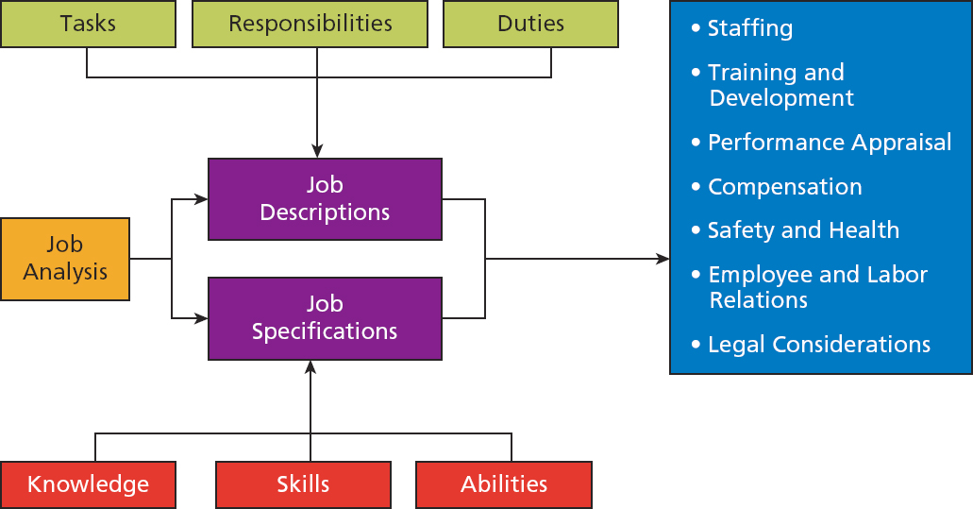
Job Analysis: A Basic Human Resource Management Tool
Notes:
In today’s rapidly changing work environment, job analysis is critical to meet company objectives. As new jobs are created, old jobs may need to be redesigned or eliminated. Also, data derived from job analysis in the form of the job description/specification can have an impact on virtually every aspect of HR management. In practice, both the job description and job specification are combined into one document with the job specification presented after the job description.
Ultimately, job analysis can help inform the array of HR decisions in each of the functional areas. For example, staffing involves selecting and placing individuals who possess the required knowledge, skills, and ability, which differ from job to job. Job analysis helps identify training and development needs such as informing HR professionals about the kind of training that is needed to help employees gain the required knowledge, skills, and abilities required to perform the job. Job analysis helps establish the performance criteria that vary with different jobs. In the area of compensation, it is helpful to know the relative value of a particular job to the company before a dollar value is placed on it. Information derived from job analysis is also valuable in identifying safety and health considerations. Job analysis is helpful in the employee and relations area by identifying the standards for promotion, transfer, or demotion. The need for job analysis is well documented in the Uniform Guidelines. Job analysis can help defend decisions involving termination, promotions, transfers, and demotions

Slide 15
Job Analysis Methods
Questionnaires
Observation
Interviews
Employee recording
Combination of methods
Notes:
Job analysis is conducted in different ways according to an organization’s needs and resources.
At the minimum, the employee and the employee’s immediate supervisor should participate in job analysis. Large organizations may have one or more job analysts, small organizations may use line supervisors, and other organizations my hire consultants. Regardless of approach, the analyst should—before conducting job analysis—learn as much as possible about the job by reviewing organizational charts and talking with individuals acquainted with the jobs to be studied.
Selecting a specific method should be based on how the information will be used, such as for job evaluation, pay increases, development, etc.
The most common methods of job analysis are discussed in the following slides.

Slide 16
Questionnaires
Typically quick and economical
Potential problems:
Employees might lack verbal skills
Employees might exaggerate the significance of their tasks
Notes:
Questionnaires are typically quick and economical to use. The job analyst administers a structured questionnaire to employees, who identify the tasks they perform.
But some employees lack the verbal or written skills to provide the desired information and others exaggerate their tasks by suggesting more responsibility than actually exists.

Slide 17
Observation
Analyst watches worker perform job tasks and records observations
Used primarily to gather information emphasizing manual skills
Often insufficient when used alone
Difficult when mental skills are dominant in a job
Notes:
Job analysts use the observation method to watch the worker perform job tasks and records their observations. This method is used primarily for jobs emphasizing manual skills, although it can help identify interrelationships between physical and mental tasks. Observation alone is not sufficient for conducting job analyses where mental skills are dominant.

Slide 18
Interviews
Interview both employee and supervisor
Interview employee first, helping him or her describe duties performed
After interviews, analyst normally contacts supervisor for additional information
Notes:
Interviewing both the employee and supervisor provides a good understanding of the job. The analyst first interviews the employee to describe the duties performed.
Then, she contacts the supervisor for additional information, to check the accuracy of the information obtained from the employee, and to clarify certain points.

Slide 19
Employee Recording
Employees describe daily work activities in diary or log
Valuable in understanding highly specialized jobs
Problem: Employees might exaggerate job importance
Notes:
Sometimes, job analysis information is gathered by having employees describe their daily work activities in a diary or log. With this method, the problem of employees exaggerating job importance may have to be overcome. Even so, valuable understanding of highly specialized jobs, such as recreational therapist, may be obtained in this way.

Slide 20
Combination of Methods
Analysts usually use more than one method
Clerical and administrative jobs (example):
Questionnaires supported by interviews and limited observation
Production jobs: Interviews supplemented by extensive work observation
Notes:
An analyst usually combines methods to produce accurate job descriptions and specifications. For example, a questionnaire may be supported by interviews and limited observation.

Slide 21
Job Description
Document that states:
Tasks
Duties
Responsibilities
Content includes:
Job identification
Job analysis date
Job summary
Duties performed
Job specification
Notes:
Information obtained through job analysis is crucial to developing job descriptions. This document should provide accurate, explicit, and concise statements of what employees are expected to do, how they are to do it, and the conditions under which the duties are performed.
The job description frequently includes major duties, the percentage of time devoted to each duty, performance standards, working conditions and potential hazards, the number of employees performing the job and to whom they report, and the equipment used on the job.
The job description contains several components.
The job identification section includes the job title, department, reporting relationship, and job number or code. Job titles can be misleading, especially between one company and another.
The job analysis date is placed on the job description to identify job changes that would make the description obsolete. Some firms have placed an expiration date on the document to ensure periodic review of job content and minimize the number of obsolete job descriptions.
The job summary is a short paragraph that states job content.
The body of the job description delineates the major duties to be performed. Essential functions may be shown in a separate section to aid in complying with the Americans with Disabilities Act.
The job specification documents the minimum acceptable qualifications that a person should possess to perform a particular job.

Slide 22
Standard Occupational Classification (S O C) and Occupational Information Network (O*N E T)
S O C: classify workers into occupational categories
O*N E T: Comprehensive government-developed database of:
Worker attributes
Job characteristics
Primary source of occupational information
Notes:
The U.S. Bureau of Labor Statistics created and updates the Standard Occupational Classification (SOC) system, which is used by federal statistical agencies to classify workers into occupational categories for the purpose of collecting, calculating, or disseminating data. The federal government updates job descriptions for all U.S. workers every ten years. This update permits professional organizations and labor groups to seek recognition or a higher profile for their members’ occupations by gaining a separate listing or reclassification.
O*NET, the Occupational Information Network, is a comprehensive, government-developed database of worker attributes and job characteristics. It’s the nation’s primary source of occupational information, which provides a common language for defining and describing occupations, as well as capturing rapidly changing job requirements. It’s the foundation for facilitating career counseling, education, employment, and training activities.

Slide 23
Competencies and Competency Modeling
Competencies refer to an individual’s capability to orchestrate and apply combinations of knowledge, skills, and abilities consistently over time to perform work successfully in the required work situations
Competency modeling specifies and defines all the competencies necessary for success in a group of jobs that are set within an industry context
Notes:
The term competency has become an increasingly important topic in HR practice because of the changing nature of work. Competencies build on the use of knowledge, skills, and abilities, which we describe with job analysis, to describe work. Traditionally, as we have seen, work has been described by many dimensions including knowledge, skills, and abilities. Indeed, although this is largely still the case, HR professionals have embraced the ideas of competencies as the field has increasingly taken on strategic importance.
Competencies refer to an individual’s capability to orchestrate and apply combinations of knowledge, skills, and abilities consistently over time to perform work successfully in the required work situations.
Competency modeling specifies and defines all the competencies necessary for success in a group of jobs that are set within an industry context.

Slide 24
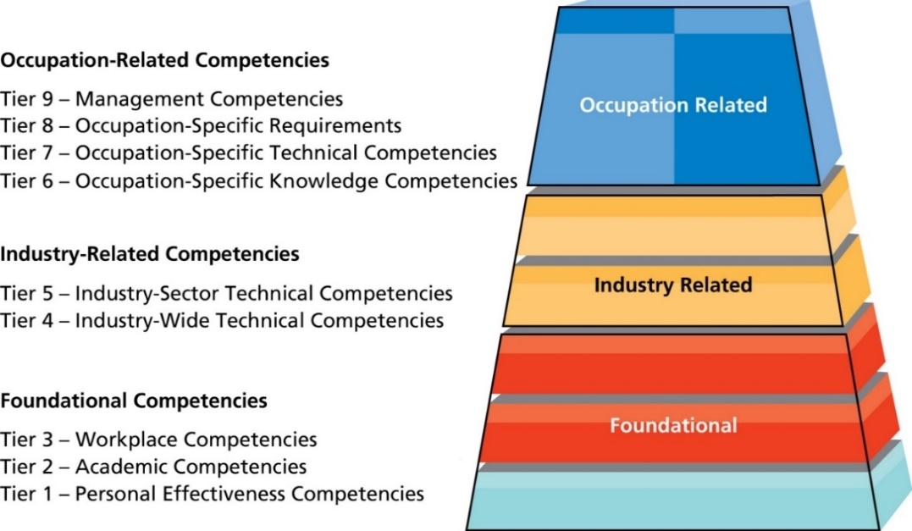
Figure 4.8 U.S. Department of Labor Competency Model
Source: U.S. Department of Labor Employment and Training Administration, “Competency Model General Instructions,” CareerOneStop (2014). Accessed January 5, 2014, at http://www.careeronestop.org/CompetencyModel/CareerPathway/CPWGenInstructions.aspx.
Notes:
This figure illustrates an example of a competency model for Solar Photovoltaic Installers who work in the renewable energy industry.
Foundational Competencies
At the base of the model, Tiers 1 through 3 represent competencies that provide the foundation for success in school and in the world of work. Foundational competencies are essential to a large number of occupations and industries. Employers have identified a link between foundational competencies and job performance and have also discovered that foundational competencies are a prerequisite for workers to learn industry-specific skills.
Industry-Related Competencies
The competencies shown on Tiers 4 and 5 are referred to as Industry Competencies and are specific to an industry or industry sector. Industry-wide technical competencies cut across industry subsectors making it possible to create career lattices where a worker can move easily across industry subsectors. Rather than narrowly following a single occupational career ladder, this model supports the development of an agile workforce.
Occupation-Related Competencies
The competencies on Tiers 6, 7, 8, and 9 are referred to as Occupational Competencies. Occupational competency models are frequently developed to define performance in a workplace, to design competency-based curriculum, or to articulate the requirements for an occupational credential such as a license or certification.

Slide 25
Job Design Concepts
Process of determining specific tasks to be performed, the methods used in performing these tasks, and how a job relates to other work in an organization
Methods:
Job enrichment
Job enlargement
Job rotation
Re-engineering
Notes:
New jobs are rapidly being created, so job design is the necessary process of determining the specific tasks to be performed, the methods used in performing these tasks, and how the job relates to other work in the organization.
Job enrichment consists of basic changes in the content and level of responsibility of a job so as to provide greater challenges to the worker.
Job enrichment provides a vertical expansion of responsibilities. The worker has the opportunity to derive a feeling of achievement, recognition, responsibility, and personal growth in performing the job. Although job enrichment programs do not always achieve positive results, they have often brought about improvements in job performance and in the level of worker satisfaction in many organizations. Today, job enrichment is moving toward the team level, as more teams become autonomous, or self-managed.
There is a clear distinction between job enrichment and job enlargement. Job enlargement is defined as increasing the number of tasks a worker performs, with all of the tasks at the same level of responsibility.
Job enlargement, sometimes called cross-training, involves providing greater variety to the worker. For example, instead of knowing how to operate only one machine, a person is taught to operate two or even three, but no higher level of responsibility is required. Workers with broad skills may become increasingly important as fewer workers are needed because of tight budgets. Some employers have found that providing job enlargement opportunities improves employee engagement and prevents stagnation.
Job rotation (cross-training) moves employees from one job to another to broaden their experience. Higher-level tasks often require this breadth of knowledge. Rotational training programs help employees understand a variety of jobs and their interrelationships, thereby improving productivity. Job rotation is often used by organizations to relieve boredom, stimulate better performance, reduce absenteeism, and provide additional flexibility in job assignments. Also, if the task to be accomplished is boring or distasteful, job rotation means that one person will not be stuck with it for all time.
Reengineering is “the fundamental rethinking and radical redesign of business processes to achieve dramatic improvements in critical contemporary measures of performance, such as cost, quality, service, and speed.”
It emphasizes the radical redesign of work in which companies organizes around process instead of by functional departments.

Slide 26
Copyright

